Slide 1


Task 3
Data Analysis

Slide 2


Today's agenda
Project recap
Problem
The Analytics team
Process
Insights
Summary

Slide 3

Client Objectives: Social Buzz, a rapidly growing tech unicorn, needs to scale efficiently to match its global ambitions.
Scope of Work: Accenture embarked on a 3-month Proof of Concept (POC) focused on three key tasks to support Social Buzz's expansion.
Big Data Audit: Conducted a thorough audit of Social Buzz's big data practices to ensure scalability and efficiency.
IPO Recommendations: Provided strategic recommendations to prepare Social Buzz for a successful Initial Public Offering (IPO).
Content Analysis: Analyzed data to identify the top 5 most popular content categories, critical for content strategy optimization.
Project Recap

Slide 4

.
Problem
Large data to process
Social Buzz's vast and complex data posed challenges in quality, integration, and performance. Efficient techniques were crucial to process, merge, and analyze the data, ensuring reliable insights, like identifying the top 5 content categories.

Slide 5



Andrew Fleming (Chief Technical Architect): Technical oversight and architecture.
The Analytics team
Marcus Rompton (Senior Principal): Strategic direction and alignment.
Our team’s expertise is crucial in navigating the complexities of the analysis and ensuring our findings are robust
Bhargavi K(Data Analyst Intern): Data analysis and interpretation.

Slide 6
Process
1
Analysis of Dataset
Analysis of Dataset: We identified that Social Buzz needed a thorough analysis of their existing datasets to extract meaningful insights for growth.
Clean Data: The data was inconsistent and required cleaning to remove inaccuracies and ensure reliability.
Merging of Data: Data from multiple sources had to be merged, creating a unified dataset to provide a comprehensive view of content performance.
Top 5 Categories of Content Analysis: The primary challenge was to analyze this unified dataset to identify Social Buzz's top 5 most popular content categories, crucial for informing content strategy.
Feedback and Reforming: Based on the feedback the improvement and the priorities are given to those categories that are popular.
2
Clean Data
3
Merging of Data
4
Top 5 Categories of Content Analysis
5
Feedback and Reforming

Slide 7

Insights
Top 5 Performing Categories: Focus on creating more content in the top-performing categories as they drive the most engagement.
Reactions in the Most Popular Category: The most popular category has the highest engagement, so prioritize similar content to maintain interest.
Month with the Most Posts: The busiest month indicates a peak in audience activity; plan future content releases around this period.
Top 5 Performing Categories
Reactions in the Most Popular Category
Month with the Most Posts
Animals
Science
Healthy Eating
Technology
Food
Animals category had the most reactions
January

Slide 8
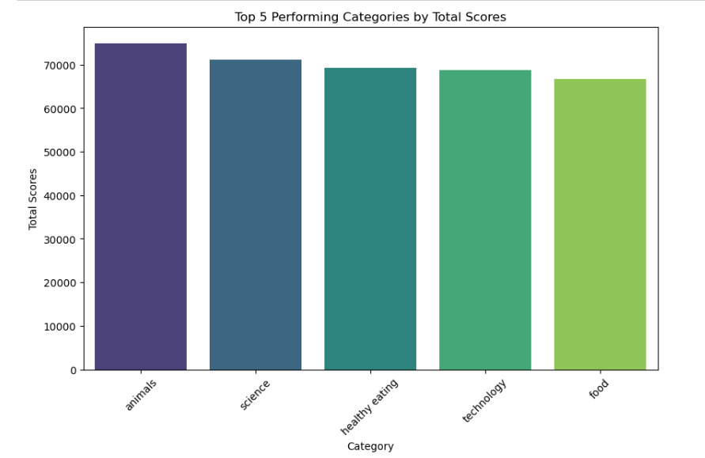

Slide 9
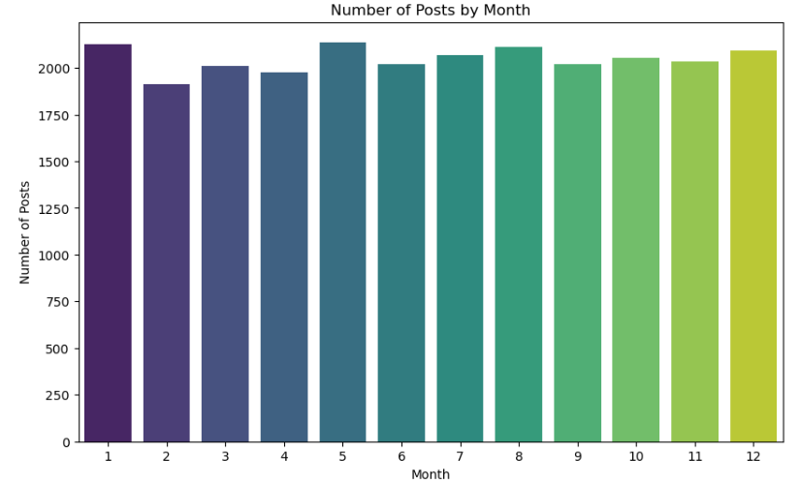
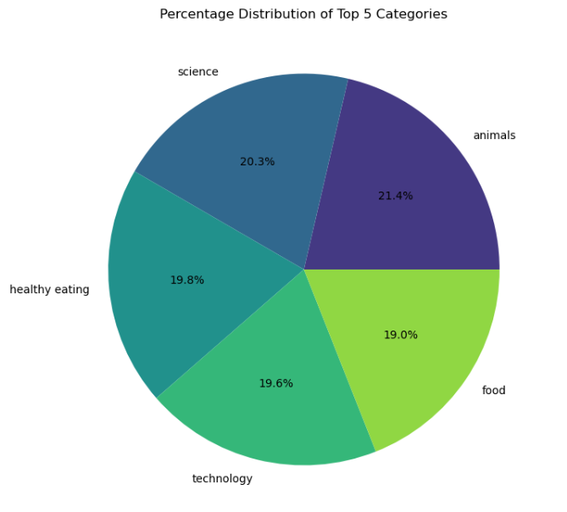

Slide 10

The analysis reveals that the top 5 content categories are driving the most engagement, suggesting that focusing on these areas could significantly boost overall performance. With a wide variety of unique categories in the dataset, it might be beneficial to streamline and concentrate on the ones that consistently perform well. The most popular category, in particular, shows high engagement, indicating that similar content should be prioritized. Additionally, identifying the month with the most posts highlights a peak in audience activity, which can be leveraged for future content planning. Overall, a content strategy that emphasizes high-performing categories during peak periods will likely yield the best results, while less impactful categories could be reduced or refocused.
Summary

Slide 11
Thank you!

